Slide 1


DATA221 Intro Machine Learning 12-Perceptron + neural networks
William Trimble
Spring 2023

Slide 2
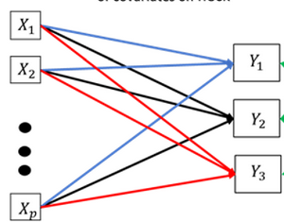
Linear decision boundaries are limiting. Layering won’t help.
Multiple layers like this is not going to work.

Slide 3
One attack is to augment feature space with nonlinear terms.
X = { 1 , x, x², x³, x⁴, x⁵ } (polynomials)
X = { 1, x, y, xy, x², y² } (interaction terms)
X = { 1,x , sqrt(1 – x²) } (coordinate transformations)
X = { tanh(x/y), sqrt(x²+y²) } (coordinate transformations)

Slide 4
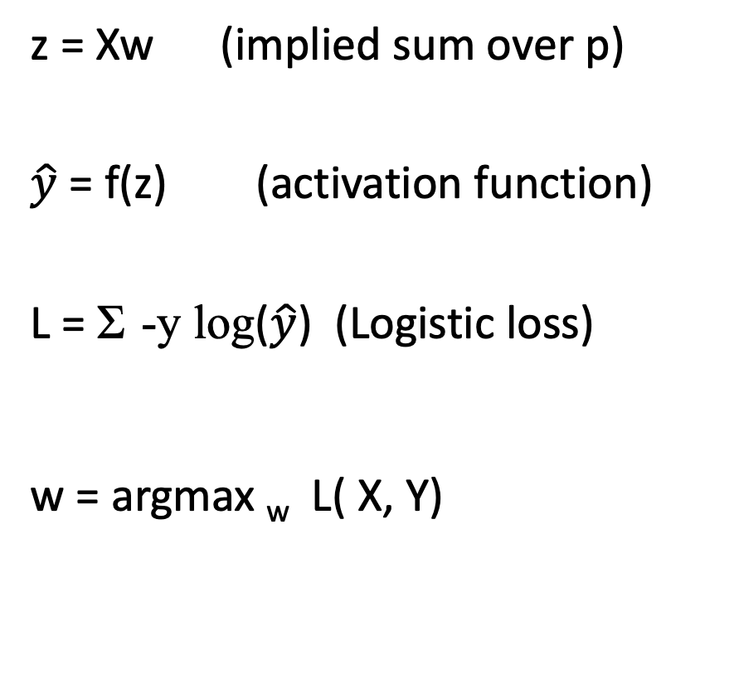
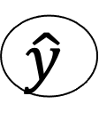
Another attack is to add nonlinearity + layers
z = Xw (implied sum over p)
$\hat{y}$ = f(z) (activation function)
L = Σ -y log($\hat{y}$) (Logistic loss)
w = argmax _{w} L( X, Y)
1
w₀
X₁
w₁
X₂
w₂
Σ
f
$$\hat{y}$$
w₃
X₃
w_{p}
X_{p}

Slide 5
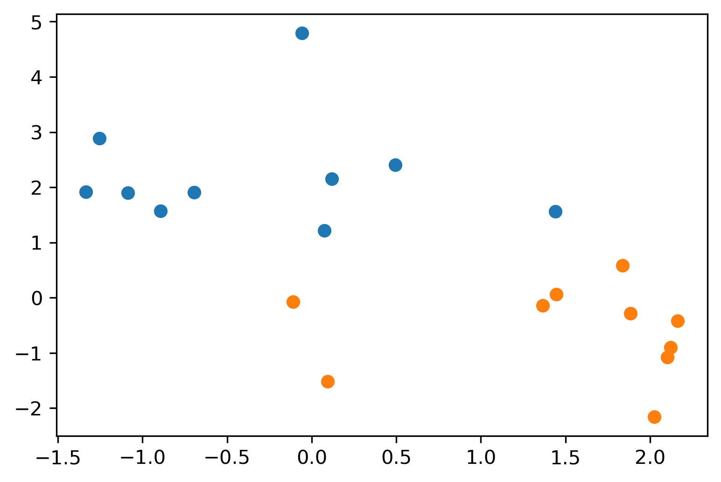
Perceptron
Clever linear model+ algorithm published by Rosenblatt 1958
For linearly separable problems

Slide 6
Perceptron
Clever linear model+ algorithm published by Rosenblatt 1958
Electrical engineering perspective; not math; this was imagined as a machine with variable resistors for weights
The update procedure effects gradient descent

Slide 7
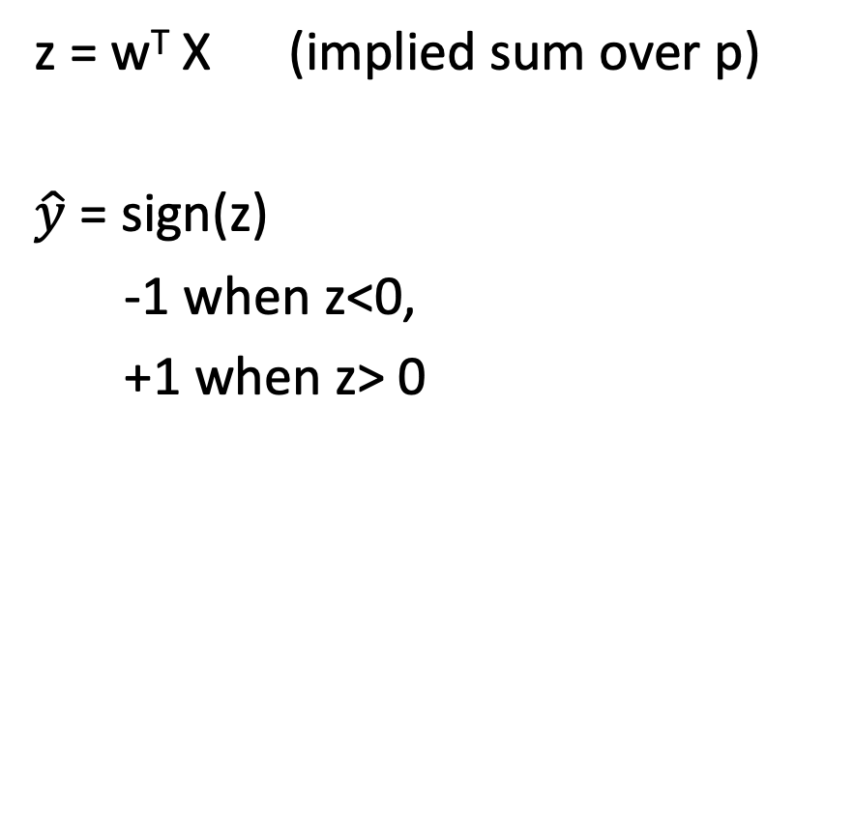
Another attack is to add on complexity
z = w^{T} X (implied sum over p)
$\hat{y}$ = sign(z)
-1 when z<0,
+1 when z> 0
1
w₀
X₁
w₁
X₂
w₂
Σ
$$\hat{y}$$
w₃
X₃
w_{p}
X_{p}

Slide 8
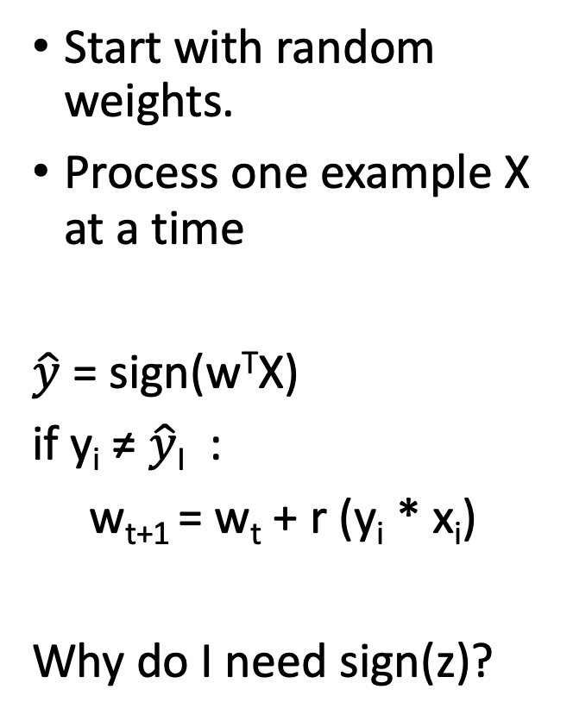
Perceptron algorithm
Start with random weights.
Process one example X at a time
$\hat{y}$ = sign(w^{T}X)
if y_{i} ≠ $\hat{y}$_{I} :
w_{t+1} = w_{t} + r (y_{i} * x_{i})
Why do I need sign(z)?

Slide 9
Perceptron algorithm
Start with random weights.
Process one example X at a time
$\hat{y}$ = sign(w^{T}X)
if y_{i} ≠ $\hat{y}$_{I} :
w_{t+1} = w_{t} + r (y_{i} * x_{i})
Why do I need sign(z)?

Slide 10
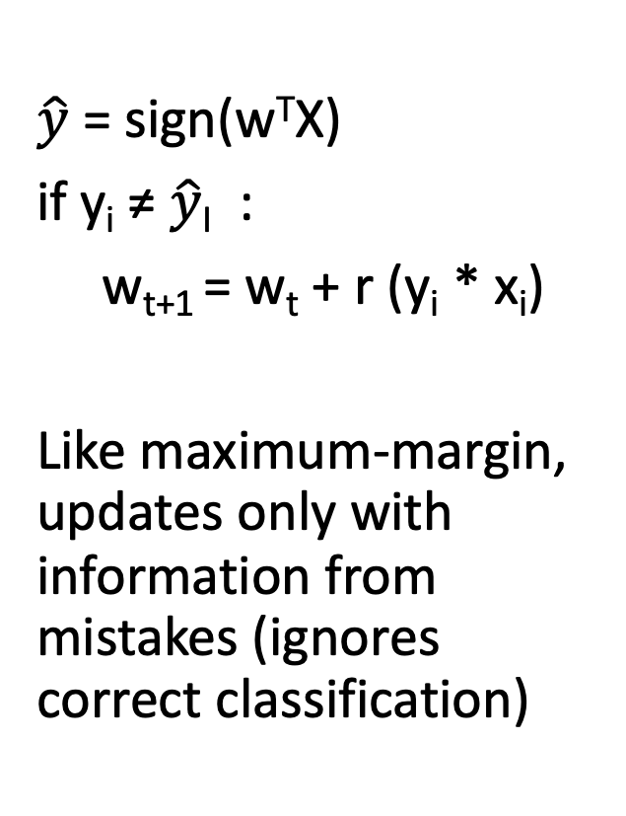
Perceptron algorithm
$\hat{y}$ = sign(w^{T}X)
if y_{i} ≠ $\hat{y}$_{I} :
w_{t+1} = w_{t} + r (y_{i} * x_{i})
Like maximum-margin, updates only with information from mistakes (ignores correct classification)

Slide 11
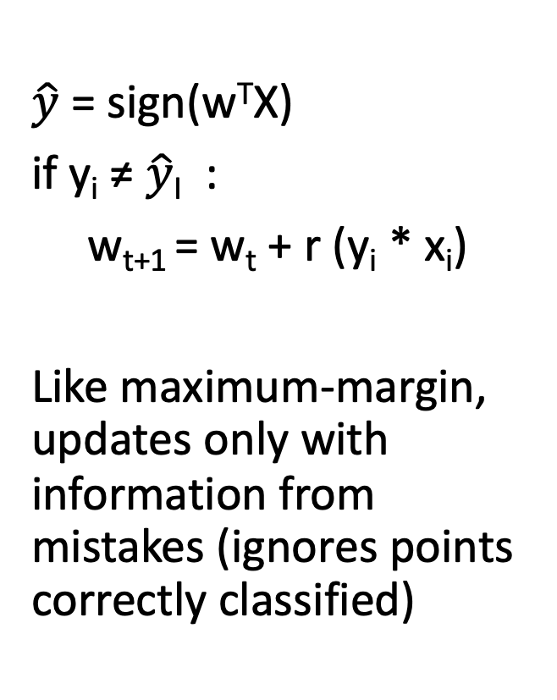
Perceptron algorithm
$\hat{y}$ = sign(w^{T}X)
if y_{i} ≠ $\hat{y}$_{I} :
w_{t+1} = w_{t} + r (y_{i} * x_{i})
Like maximum-margin, updates only with information from mistakes (ignores points correctly classified)

Slide 12
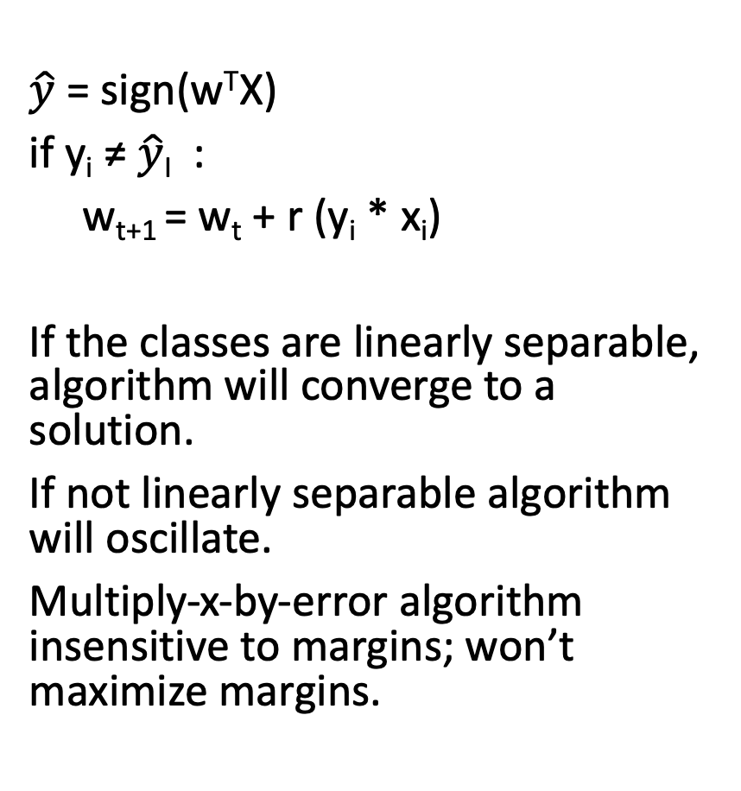
Properties of perceptron
$\hat{y}$ = sign(w^{T}X)
if y_{i} ≠ $\hat{y}$_{I} :
w_{t+1} = w_{t} + r (y_{i} * x_{i})
If the classes are linearly separable, algorithm will converge to a solution.
If not linearly separable algorithm will oscillate.
Multiply-x-by-error algorithm insensitive to margins; won’t maximize margins.

Slide 13

Neural networks
Marvelously successful name for a mathematical model.
”Inspired by biological computing gates” is not magic!! This is a configurable multiple-input multiple-output function.

Slide 14

Researchers turned up the hype from the very beginning
New York Times July 8, 1958
“Having told you about the giant digital computer known as I.B.M. 704 and how it has been taught to play a fairly creditable game of chess, we’d like to tell you about an even more remarkable machine, the perceptron, which, as its name implies, is capable of what amounts to original thought. The first perceptron is yet to be built, but it has been successfully simulated on a 704, and it’s only a question of time (and money) before it comes into existence. This about-to-be marvel is a lot more subtle than the 704; indeed, it strikes us as the first serious rival to the human brain ever devised, and our brain is thoroughly dazzled by the things it is said to do.” (New Yorker, Dec 6, 1958 p44)

Slide 15
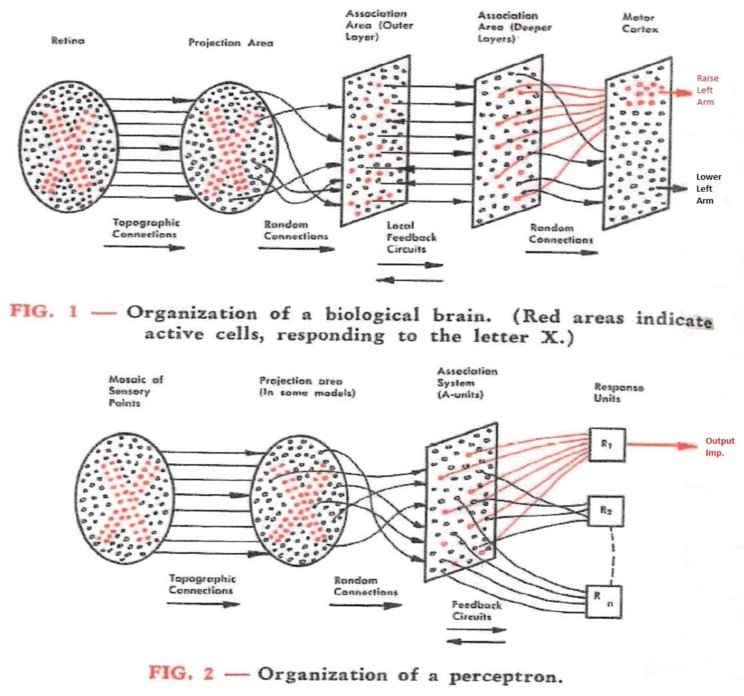

Slide 16

0-layer neural network: logistic regression
Input layer (p)
Output layer (d)
1
$$Σ$$
y₁
z₁ = tanh ( y₁)
X₁
y₂
z₂ = tanh ( y₂)
X₂
y₃
z₃ = tanh ( y₃)
X₃
$$Σ$$
y_{d}
z_{d} = tanh ( y_{d})
X_{r}
w (n₁ x d)

Slide 17
0-layer neural network: logistic regression
Input layer (p)
Output layer (d)
1
$$Σ$$
y₁
The object to be optimized here is a (r+1) * d rectangular matrix of weights.
z₁ = tanh ( y₁)
X₁
y₂
z₂ = tanh ( y₂)
X₂
y₃
z₃ = tanh ( y₃)
X₃
$$Σ$$
y_{d}
z_{d} = tanh ( y_{d})
X_{r}
w (n₁ x d)

Slide 18
Basic neural network
Input layer (p)
Hidden layer (n₁)
Output layer (d)
1
z₁
y₁
X₁
z₂
y₂
X₂
z₂
y₂
X₃
z₃
y_{d}
X_{r}
w (n₁ x r)
w (d x n₁)

Slide 19
Deep neural network
Input layer (p)
Hidden layer (n₁)
Hidden layer (n₁)
Output layer (d)
1
z₁
z₁
y₁
X₁
z₂
z₂
y₂
X₂
z₂
z₂
y₂
X₃
z₃
z₃
y_{d}
X_{r}
w (n₁ x r)
w (n₂ x n₁)
w (d x n₂)

Slide 20
Activation functions
ReLu (“Rectified linear unit”)
relu(z) = z * (z > 0)
(Why? derivative is easy to calculate; 0 or 1)
sigmoid function
sigmoid(z) = (exp z) / (1+exp z)
hyperbolic tangent
tanh(z) = (exp (z) – exp(-z) ) / (exp(z) + exp(-z))
(Why? derivative is continuous; makes mathy people more comfortable.)
linear
Lets you test that things are kind of sort of working by falling back to logistic regression.

Slide 21
Neural networks
Universal function approximators
Vast parameter space: can overfit; can fit the data millions of (different) ways at the same level of accuracy
Loads of regularization tricks to stabilize quality of fit
Can take a long time to train
You might or might not be able to explain the weights

Slide 22
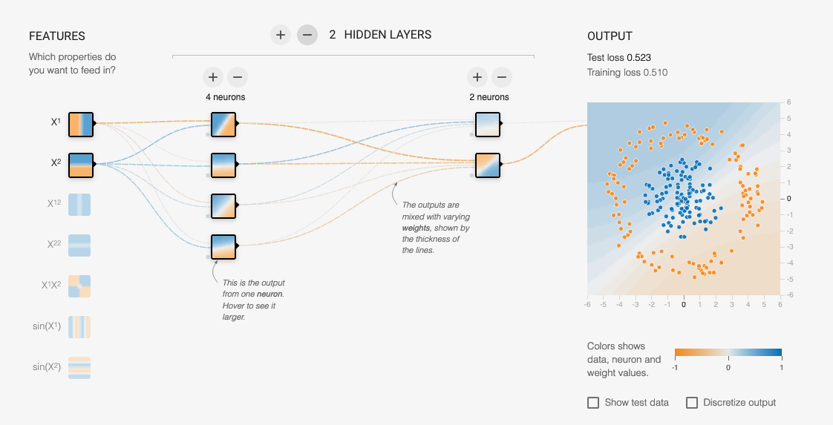
A Neural network playground
https://playground.tensorflow.org/

